Slide 1
自我介紹
(NizimaLive)

Slide 2
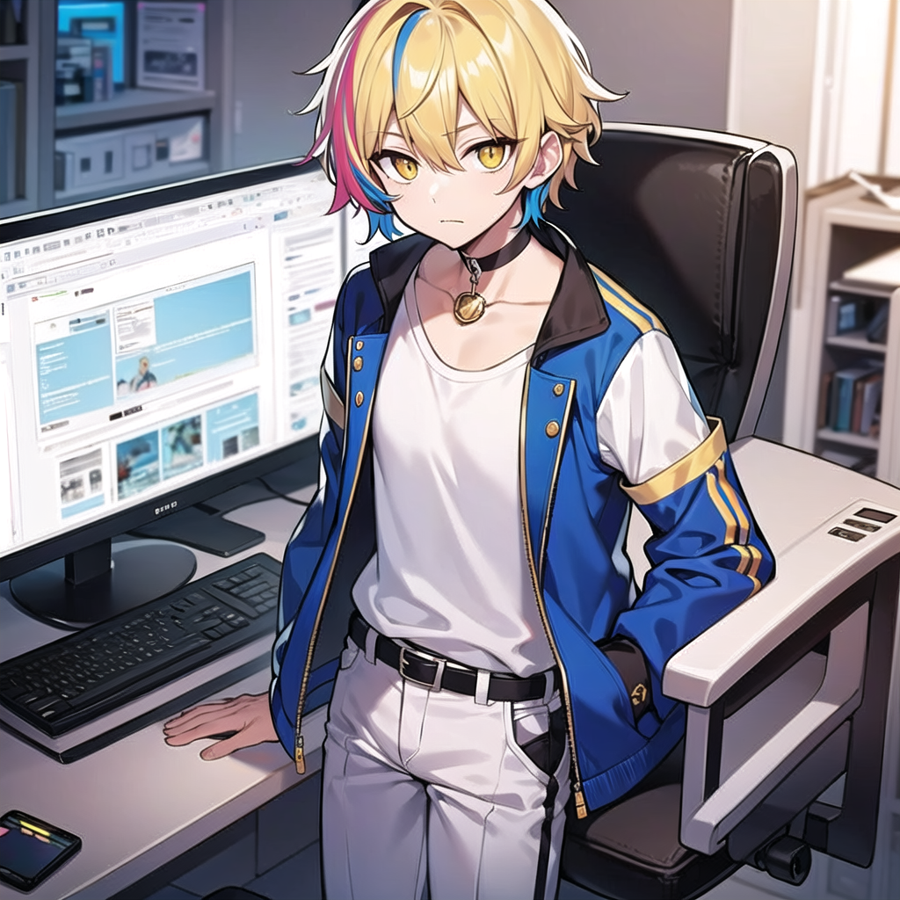
1.目標
Notes:
stable diffusion：
masterpiece, best quality, male focus, 1boy, blonde hair with blue hair highlights, blue hair highlights, (game engineer:1.4), (white t-shirt:1.4), fingerless gloves, belt, pants, black pants, black gloves, blue jacket, multicolored hair, yellow eyes, choker, solo, looking at viewer, collared shirt, streaked hair, hair between eyes, bangs, black choker, standing, sneakers, vest, closed mouth, blue jacket, necklace, collarbone,
nsfw,(worst quality, low quality:1.4),(extra fingers:1.4),negative_hand-neg,badhandv4,art by bad-artist,easynegative,ng_deepnegative_v1_75t,verybadimagenegative_v1.3
我是一名致力於遊戲開發的碩士生，決定開發一款富有創意的解謎遊戲。

Slide 3
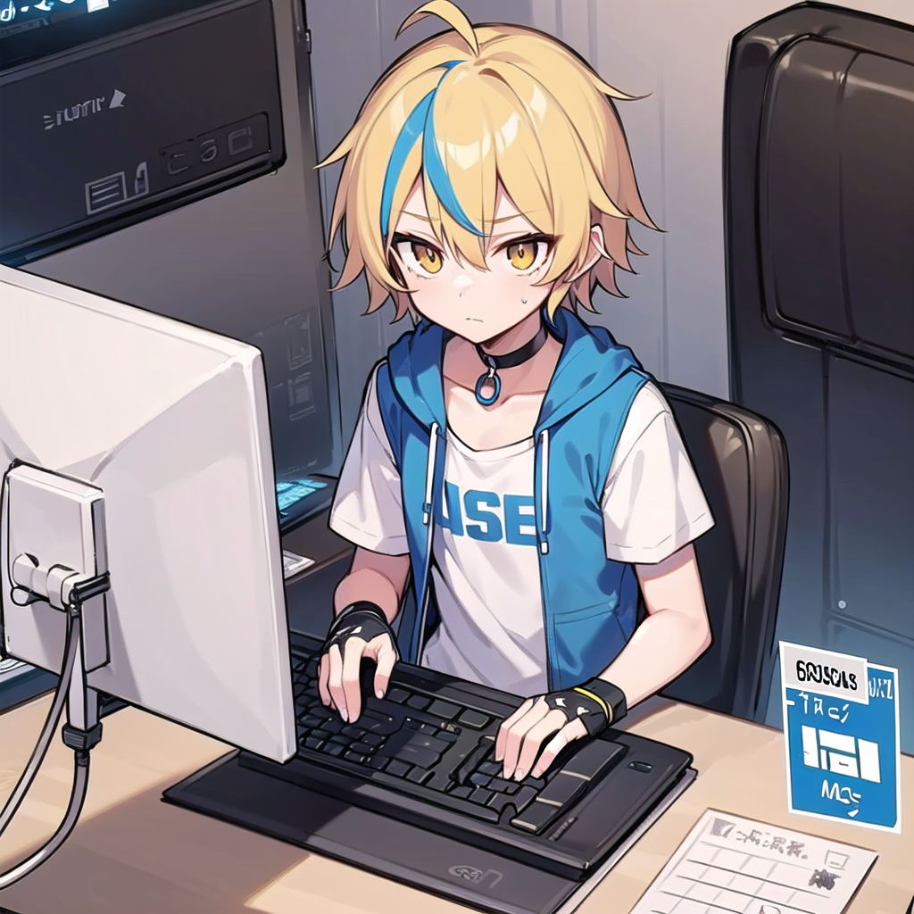
2.阻礙
Notes:
stable diffusion：
masterpiece, best quality, male focus, 1boy, blonde hair with blue hair highlights, blue hair highlights, (game engineer:1.4), (white t-shirt:1.4), Worrying at the computer desk,(fretful:1.4), (computer shows error:2), fingerless gloves, belt, pants, black pants, black gloves, blue jacket, multicolored hair, yellow eyes, choker, solo, collared shirt, streaked hair, hair between eyes, bangs, black choker, standing, sneakers, vest, closed mouth, blue jacket, necklace, collarbone,
3476999745
我心中滿懷抱負，想要設計一個獨特的遊戲機制，吸引玩家思考與挑戰。但隨著我深入開發，卻發現遊戲中的關鍵算法性能太差，導致遊戲運行不順暢

Slide 4
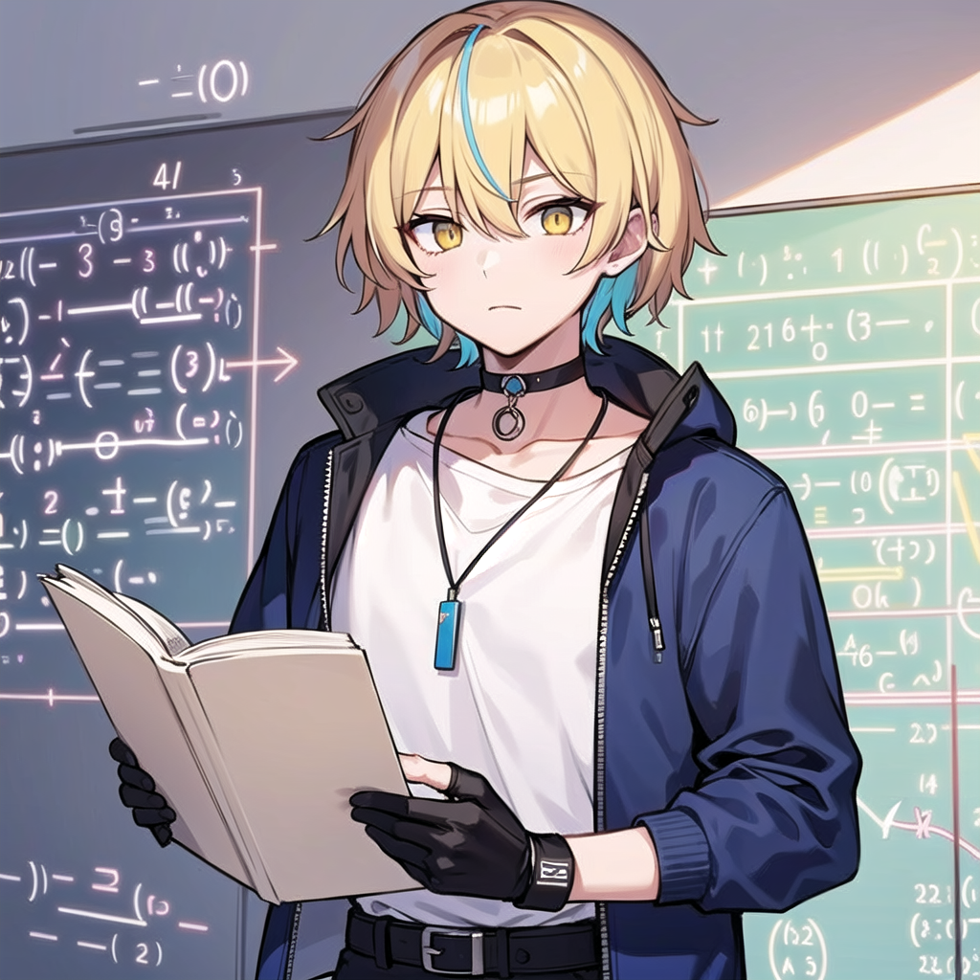
3.努力
Notes:
masterpiece, best quality, male focus, 1boy, blonde hair with blue hair highlights, blue hair highlights, (game engineer:1.4), (white t-shirt:1.4), (reading:1.4), (Studying math:1.4), fingerless gloves, belt, pants, black pants, black gloves, blue jacket, multicolored hair, yellow eyes, choker, solo, collared shirt, streaked hair, hair between eyes, bangs, black choker, standing, sneakers, vest, closed mouth, blue jacket, necklace, collarbone,
1992659288
不甘心放棄，我每天花時間研究不同的優化技術，甚至學習新的數學理論來改善算法

Slide 5
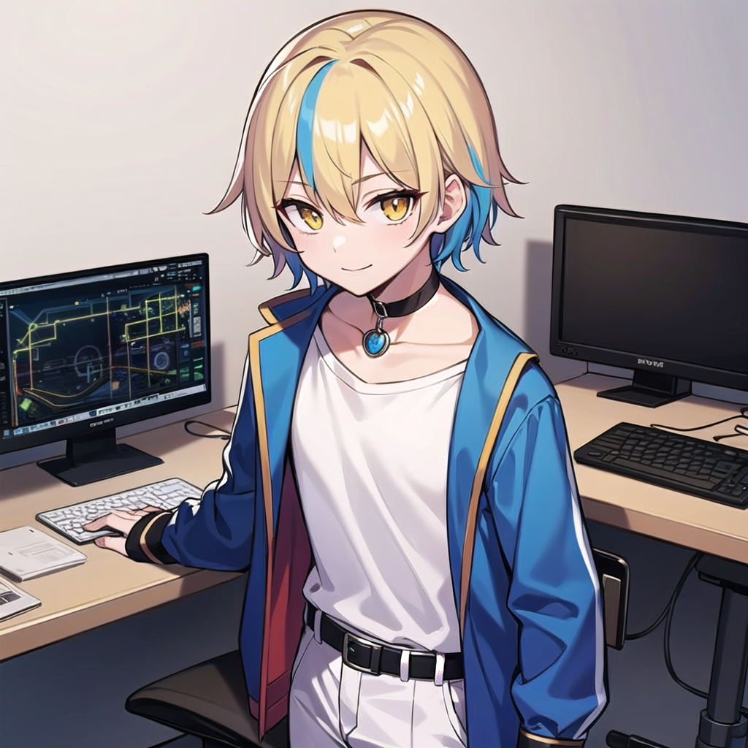
4.結果
Notes:
masterpiece, best quality, male focus, 1boy, blonde hair with blue hair highlights, blue hair highlights, (game engineer:1.4), (white t-shirt:1.4), (happy:1.4), fingerless gloves, belt, pants, black pants, black gloves, blue jacket, multicolored hair, yellow eyes, choker, solo, looking at viewer, collared shirt, streaked hair, hair between eyes, bangs, black choker, standing, sneakers, vest, closed mouth, blue jacket, necklace, collarbone,
1438539154
經過無數次的測試與調整，我終於成功提升了遊戲性能，達到了預期的目標

Slide 6
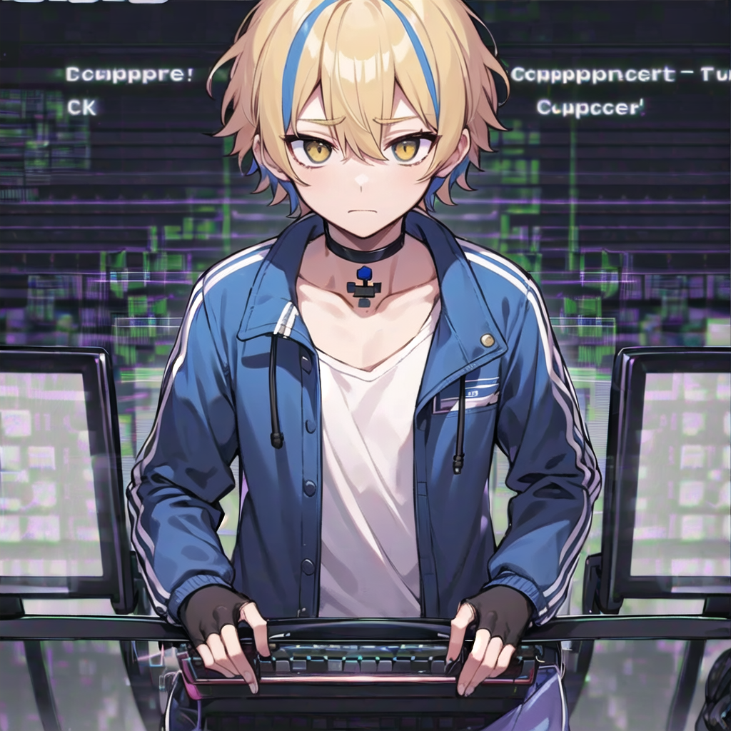
5.意外
Notes:
masterpiece, best quality, male focus, 1boy, blonde hair with blue hair highlights, blue hair highlights, (game engineer:1.4), (white t-shirt:1.4), (sad:1.4),(computer bug:2),(computer error:2), fingerless gloves, belt, pants, black pants, black gloves, blue jacket, multicolored hair, yellow eyes, choker, solo, looking at viewer, collared shirt, streaked hair, hair between eyes, bangs, black choker, standing, sneakers, vest, closed mouth, blue jacket, necklace, collarbone,
1315007744
然而，在我滿心歡喜準備發布遊戲時，意外發生了。因為某個更新包的相容性問題，遊戲無法順利運行在新版本的遊戲引擎上。

Slide 7

6.轉彎
Notes:
masterpiece, best quality, male focus, 1boy, blonde hair with blue hair highlights, blue hair highlights, (game engineer:1.4), (white t-shirt:1.4), (an idea comes:2), (surprise:1.4), (exclamation mark:1.8), fingerless gloves, belt, pants, black pants, black gloves, blue jacket, multicolored hair, yellow eyes, choker, solo, collared shirt, streaked hair, hair between eyes, bangs, black choker, standing, sneakers, vest, blue jacket, necklace, collarbone,
878583308
為了應對這個突如其來的挑戰，我果斷決定改變策略，使用另一款更加穩定的引擎重新開發遊戲。

Slide 8

7.結局
Notes:
masterpiece, best quality, male focus, 1boy, blonde hair with blue hair highlights, blue hair highlights, (game engineer:1.4), (white t-shirt:1.4), (happy:2), fingerless gloves, belt, pants, black pants, black gloves, blue jacket, multicolored hair, yellow eyes, choker, solo, looking at viewer, collared shirt, streaked hair, hair between eyes, bangs, black choker, standing, sneakers, vest, blue jacket, necklace, collarbone,
694960102
最終，我的遊戲順利發布，並因其創新的設計和流暢的體驗獲得了玩家們的熱烈好評

